Slide 1


Aviation ISAC Cybersecurity Competition
Sierra McConnell

Slide 2

Introduction
Sierra McConnell
Class of 2022
Studying Cyber Intelligence and Security with a minor in Business Administration

Slide 3
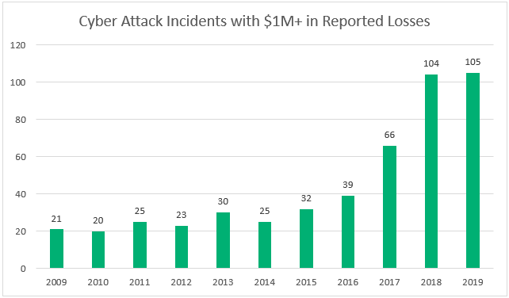
Aviation Cybersecurity Competitions
As we continue advancing technology around the world, we are faced with the constant threat of cyber-attacks.
The aviation industry requires highly skilled professionals to combat future threats.
https://sectigostore.com/blog/wp-content/uploads/2020/02/cyber-attack-statistics-reported-losses.png

Slide 4





Aviation Information Sharing & Analysis Center (Aviation ISAC)
International consortium that securely shares aviation threat intelligence across the aviation community.

Slide 5
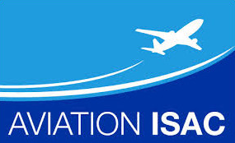


The Aviation ISAC Cybersecurity Competition
Developed a cybersecurity competition for the Aerospace Village at DefCon 28 and Aviation ISAC’s annual summit.
The Aviation ISAC competition was designed to provide an ethical scenario where participants must identify who carried out a cyber-attack against a simulated airport while retracing how this attack occurred to regain control of the airport infrastructure.

Slide 6
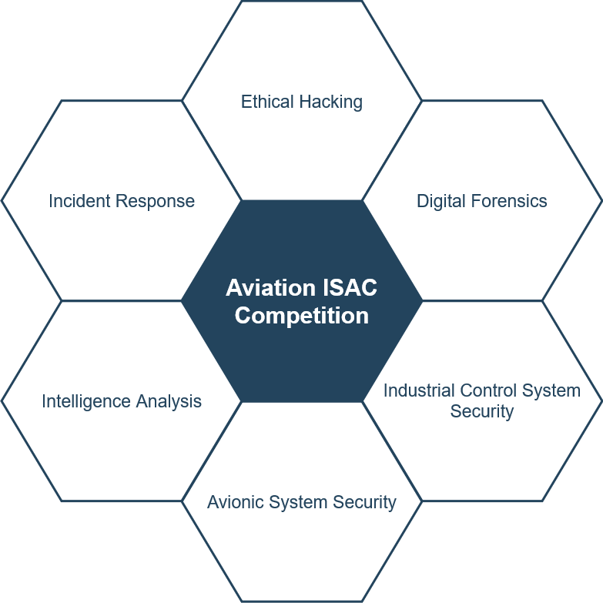

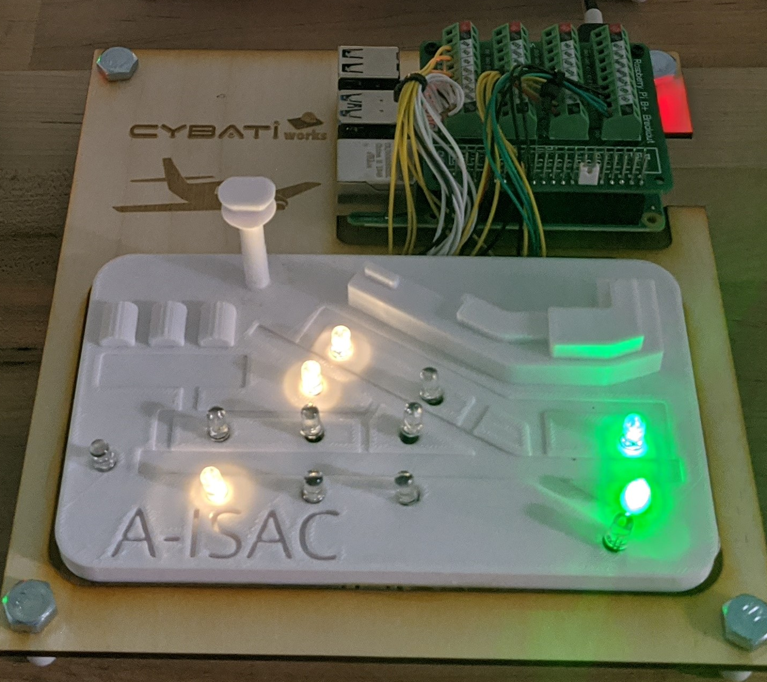
Competition Architecture

Slide 7

Competition Results
DefCon Conference:
211 Cybersecurity professionals participated
Aviation ISAC Summit:
40 International College Student Teams

Slide 8


